Slide 1
Child’s Piggy Bank
__________________________________________________
ECE411 Practicum, Fall 2019
Brigham Webster
Sarah Mehler
Jens Evans
Jose Alvarez

Slide 2

Problem / Need
The skill to save money for a goal is one that is being lost with each generation. It is important to develop good saving habits at an early age in order for a person to be financially successful in the future. Without the proper motivation or teaching tools, kids may be influenced by targeted marketing encouraging them to spend every penny they have (or more accurately their parents have) on whatever piece of candy, toy or game that is currently on their minds.
Motivation
This device will entertain children while helping them keep track of their coins. Its purpose is to aid in developing a better understanding of the values of change and develop a desire to save money at a young age. We want this device to display the current amount in the bank so that it will encourage children to continue to deposit and save their change instead of breaking the piggy bank as soon as there is something to buy. This device will encourage young ones to save for a particular goal or “more useful” purchase or even just save for savings sake. Additionally the design of this product will have an optional young engineer project approach. The affordability of this design along with the option of assembly will bring out the engineer in a slightly older child while still encouraging the values of saving.

Slide 3
Objective
Big Picture
Act like an engineering team in industry and use best practices to create a “Minimum Viable Product“ with a feature set that provides value to a consumer.
For Our Product
Design and build a piggy bank that sorts the coins inserted, stores them, counts the total amount, and displays it. The product will include the option of purchasing it assembled or “project” build oriented. The end product will be a fully functional device targeting children ages 8 - 16. For younger ages a higher level of safety and material quality will need to be implemented at a later time (not within this projects timeline).

Slide 4
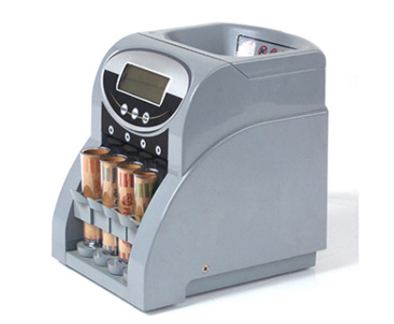
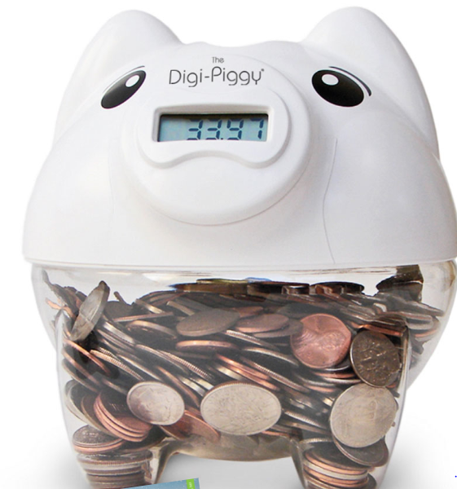
Alternatives
Most alternatives to this design are simple banks without the counting ability. There are 2 good alternatives to our product listed shown (right). While one of these options has all of the functionality of our device, it costs a whopping 120 dollars.
The second alternative is the Digi-Piggy. This product is the most similar to ours with a battery powered electrical counter. This device costs 16 dollars. While a very good alternative the Digi-Piggy is still high priced compared to the automated cost of our product estimated at $10.00. Additionally the Digi-Piggy does not have the option to assemble and alter the device easily as our “young arduino engineer” package would. An unassembled product can be easily constructed by an older child. If the child is already in possession of an arduino a detailed instruction set will help the child wire up and alter the microcontroller code and experiment with a device that would be otherwise much more difficult to edit.
$120.00
$16.00

Slide 5
Requirements
M
U
S
T
Count coins (pennies, nickels, dimes, and quarters)
Store Coins
Be easy to use
Display the amount of money that has been added in a clear and obvious way
Use atmega328 processor
Be PCB-based with 25% surface mount components
Run on a battery
Have an attractive enclosure
Make the Mario coin sound when you insert a coin
Sort coins
Be able to set a goal
Have a 3D printed animal-shaped enclosure
S
H
O
U
L
D
M
A
Y

Slide 6
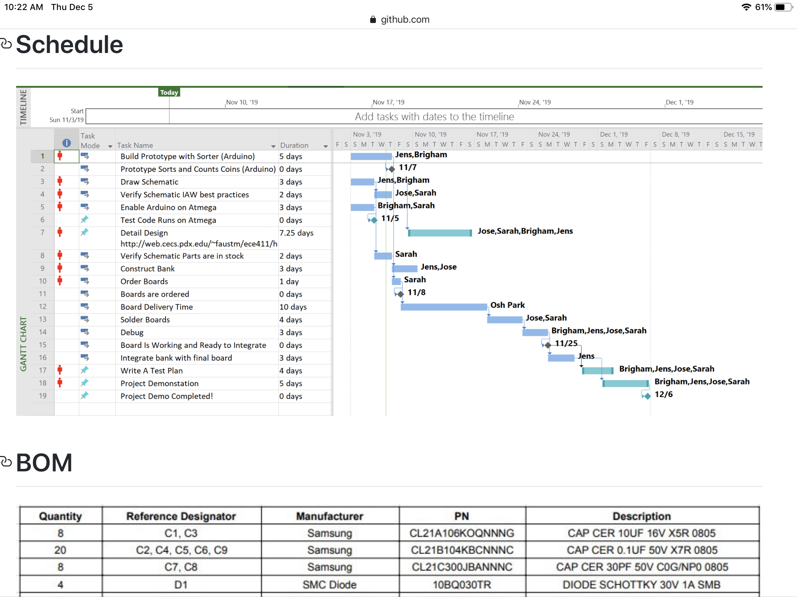
Our Approach
Timeline
Main Steps
Build prototype coin sorter using arduino
Test code on arduino
Implement on breadboard
Design PCB schematic for coin sorter using Eagle
Build mechanical coin sorter design
Order parts
Solder boards and begin testing/debugging
Integrate piggy bank design with board
Test completed design according to test plans

Slide 7
Design: Hardware
Hardware
Processor
The atmega328p was chosen for reliability and ease of integration.
Sensors
We chose to use an IR sensor instead of a switch. An IR sensor will last as long as power is provided to the circuit and easier to implement in our design than a switch.
Coin sorter
We decided to design our own mechanical coin sorter. This consists of a panel with perfectly shaped slots for each coin size.
LCD screen
For ease of integration we used a 16x2 LCD screen that is capable of communicating with the breadboard through the SDA and SCL pins only.

Slide 8
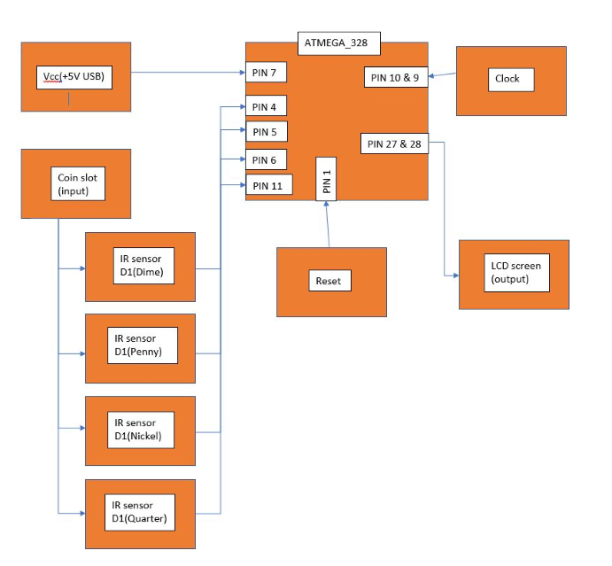
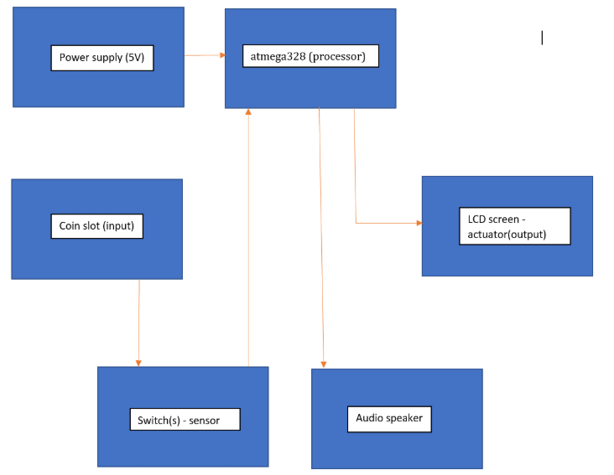
Design
Low Level Model
Next Level Model

Slide 9
Design - Code
Writing the code for this project was the shortest portion of the design process. Since we decided to implement a sorter using a mechanical process the code only needed to read input from the sensors and increase the total amount float value based on which sensor was activated. The psuedocode is displayed below running from top to bottom left to right.
#include liquidcrystal_i2c.h library
Set dimensions of LCD implemented using liquidcrystal_i2c.h library
Define float values
Quarter = .25
Dime = .10
Nickel = .05
Penny = .01
Savings = 0.00
Initialize the digital pins
Quarter pin = 2;
Dime pin = 3;
Nickel pin = 4;
Penny pin = 5;
Set the minmode for the pins
pinMode(Quarter pin, input)
pinMode(Dime pin, input)
pinMode(Nickel pin, input)
pinMode(Penny pin, input)
Display welcome message to LCD screen
Wait 3 seconds
Arduino loop {
Display current Savings float value
Read the sensor values
Int Qread = digitalRead(Quarter Pin)
Int Dread = digitalRead(Dime Pin)
Int Nread = digitalRead(Nickel Pin)
Int Pread = digitalRead(Penny Pin)
If (Qread ==0)
Savings = Savings + Quarter
delay
Else if (Dread ==0)
Savings = Savings + Dime
Delay
Else if (Nread ==0)
Savings = Savings + Nickel
Delay
Else if (Pread ==0)
Savings = Savings + Penny
Delay
}

Slide 10
Design - Circuitry
Insert BB prototype image
Insert PCB prototype image
Besides a basic arduino setup the only additional circuitry required was direct connections for the LCD and 4 sensors. A basic clock and power circuit was implemented on a breadboard prototype. This circuit was used to debug code and initially test the functionality of the sensors, code LCD and atmega328p.
After all bugs were fixed and the code ran smoothly on the atmega328p with the breadboard we implemented it on the PCB.

Slide 11
Design - Mechanical Sorter and Container
The mechanical sorter ended up being the most difficult part of the design. Not because the design itself was very difficult but because none of the equipment required to build the 3d models worked (laser cutter) or it was over budget (3d printer). With a little bit of luck after a long stroke of bad luck we were able to gain access to the mechanical engineering laser cutter. This was during dead week and although we were able to successfully cut out our sorter we ran out of time to cut out the box and had to find a premade box option at the local Michaels.

Slide 12
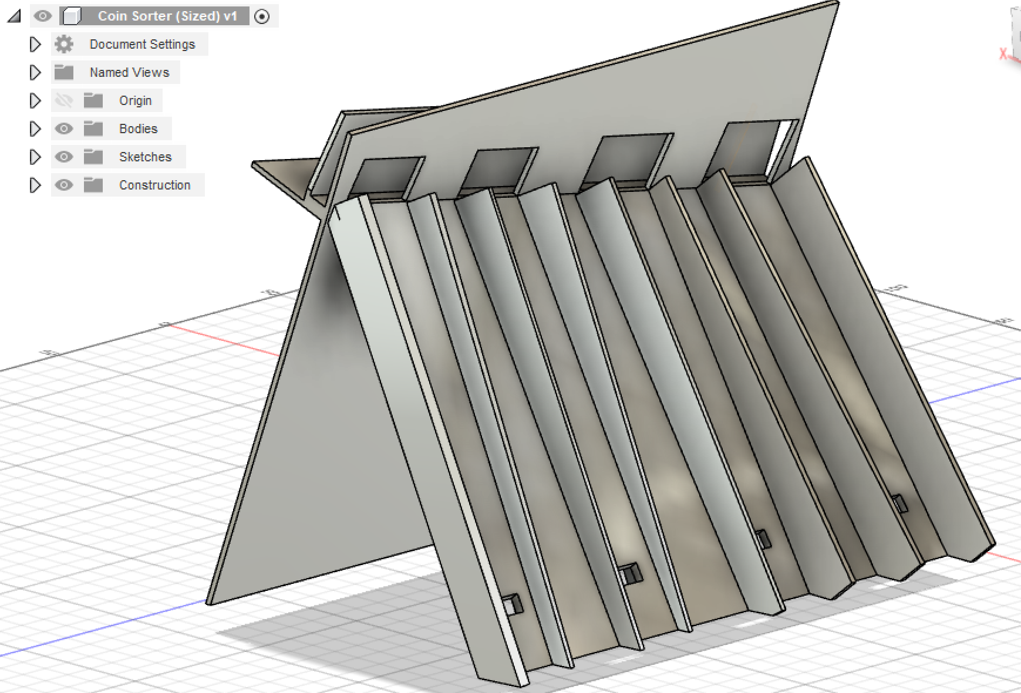
Design Model - Failed 3D Model

Slide 13
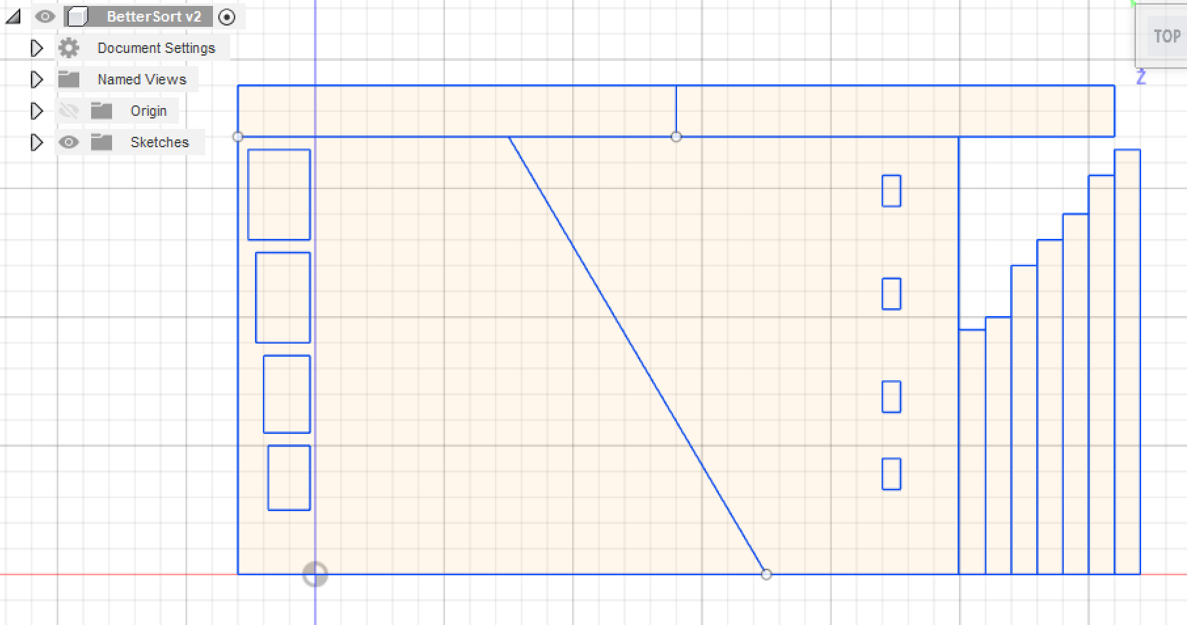
Design - Failed 2D Model

Slide 14
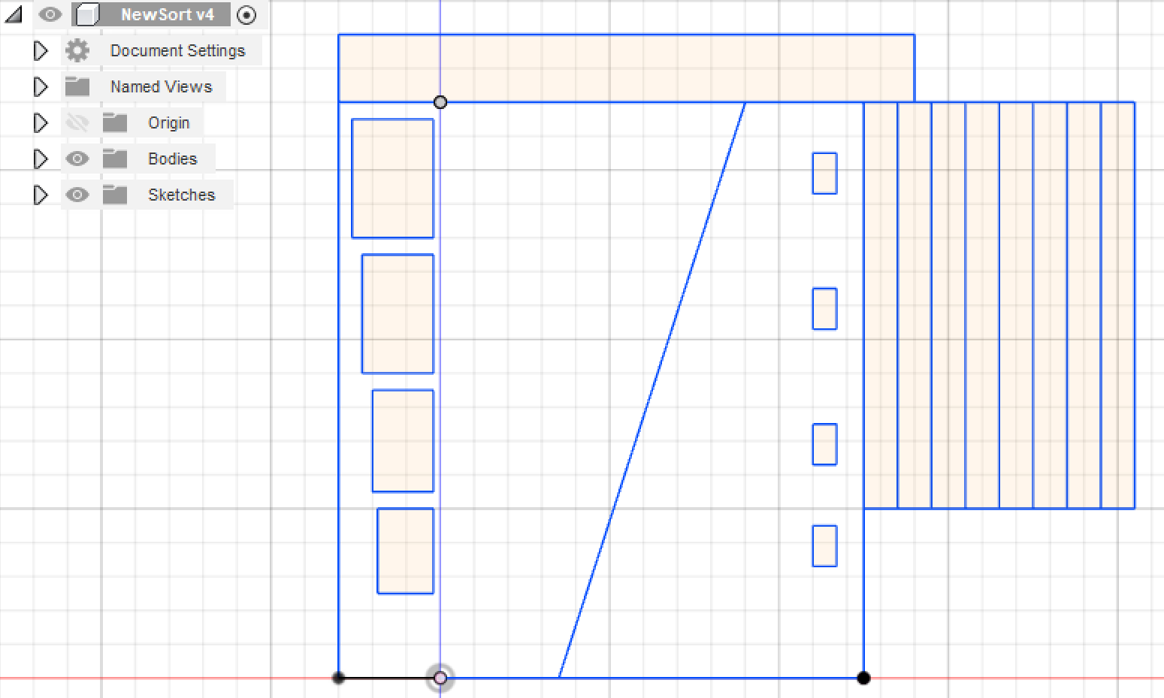
Design - Successful Coin Sorter Model

Slide 15
Implementation
Tools employed
- EAGLE CAD was used for schematic design and board layout
- Arduino was used for code implementation and prototyping
- Laser Cutters, 3d Printers and cardboard was used for making piggy bank design
- OSH PARK was used as our PCB manufacturer
Code
- Designed to only read coin values from quarters, pennies, dimes and nickels
- ATMEGA328p reads data from IR sensor and displays values on LCD
- IR sensor reads coin input depending on slot it goes in and produces an output
- To reduce coin double count, sensor has a delay of 0.5 seconds between each coin read
- Code designed to add coin values and display piggy bank total

Slide 16
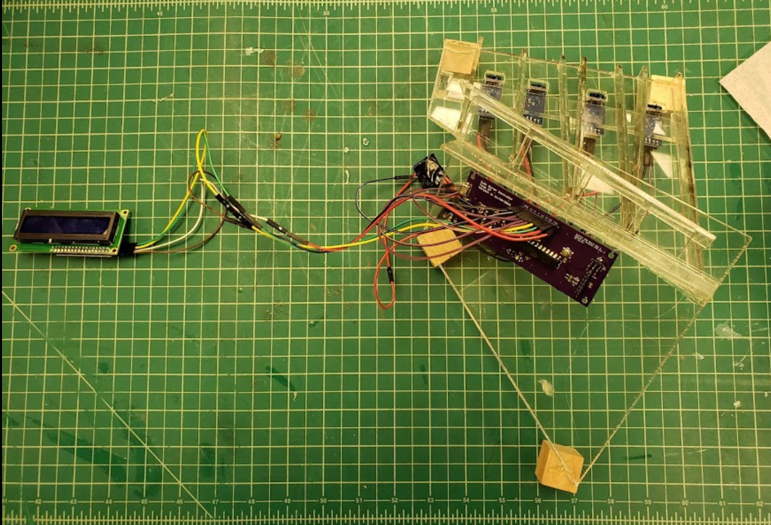
Implementation - Coin Sorter

Slide 17
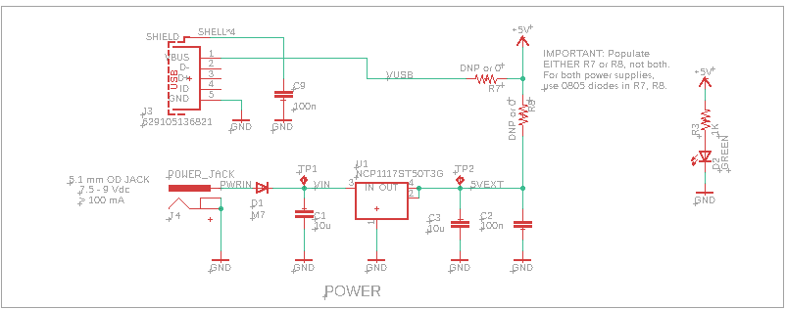
Implementation - Circuit Schematic Power

Slide 18
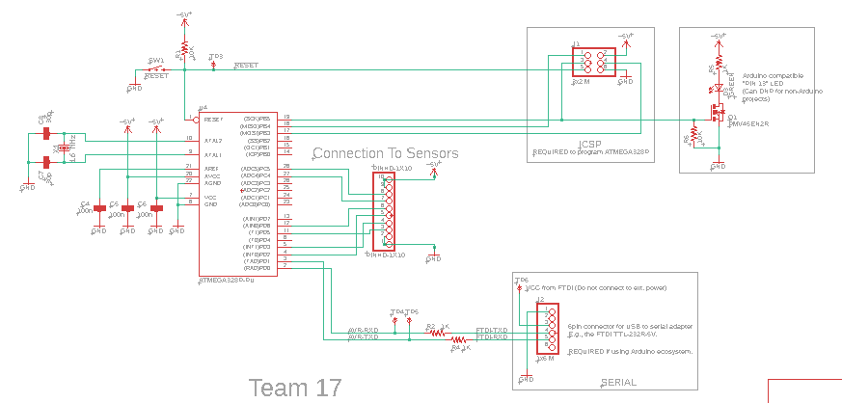
Implementation Circuit Schematic

Slide 19
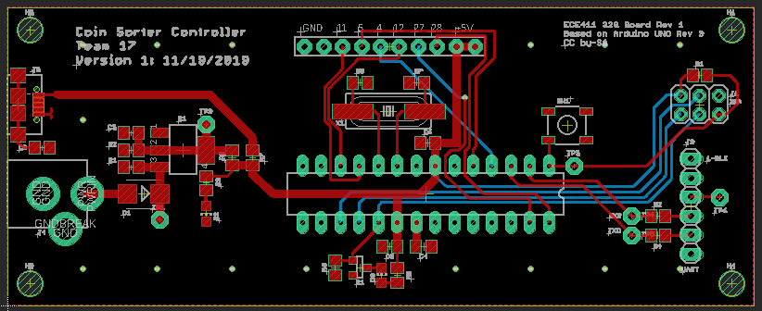
Implementation - Board Layout

Slide 20
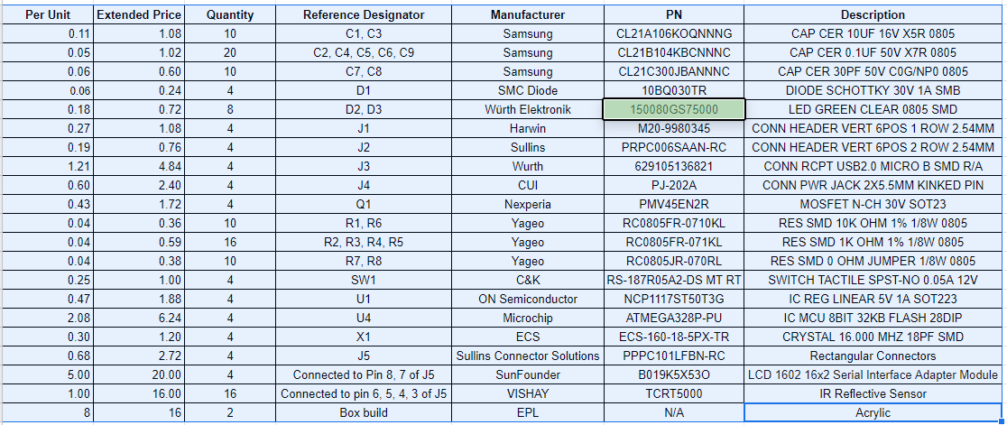
Implementation: BOM

Slide 21
Testing
Unit Testing: This section focuses on the code functionality and successful compilation.
- This test is a simple verification of the code. You will use an arduino Uno and attempt to compile and upload the code to the arduino uno. The test is successful if the code compiles and uploads successfully.
Functional Testing: This section focuses on functional verification of individual project components.
- Sensor: Wire up the sensor with 5 volts supply and attach the output of the sensor to a digital multimeter. Pass an object (your hand) in front of the sensor. When the object comes within 1 cm of the sensor there should voltage reading of the digital multimeter is a high value (5 Volts). Once the object passes completely by the sensor there should be a 0 Volts reading on the digital multimeter.

Slide 22
Testing
4.0 Unit Testing
This section focuses on the code functionality and successful compilation.
5.0 Functional Testing
This section focuses on the functional verification of individual project components.
6.0 Integration Testing
This section focuses on the functionality of verified components when integrated with one another.
7.0 Acceptance Test
The purpose of the acceptance test is to determine whether the product is acceptable to the client. In order to pass acceptance tests, the system must meet both functional and performance specifications. For the current system, the acceptance test will determine that the product is accurately recording the amount of change entered, that it is easy to use, and that it continues to function properly with repeated use.

Slide 23
Results
The Good: A fully functioning piggy bank coin counter. We were able to implement the circuit and the mechanical sorter as planned. The code worked well initially and there were minimal debugging issues.
The Bad: Most of the issues that we had were related to the mechanical sorter. The design was more difficult to implement and finding the equipment to produce the CAD files was even more difficult. Eventually were able to find a mechanical engineer that had a limited time slot during dead week to laser cut our design. Unfortunately we could not design the box container until we had built the mechanical coin sorter and by that time we had lost our laser cutting window and had to find a container at michaels to house the device.

Slide 24
Contributions
How did our team members contribute to the project?
Jose
Block diagram design for hardware specifications
Soldering components onto PCB boards
Jens
Project timeline
PCB design
Mechanical coin sorter design
Brigham
Program Writer
Project Manager/Github Updater
Sarah
Establish team communication tools
??? Did nothing technical.

Slide 25
Lessons Learned
Jose
Some of the things that I learned as a result of this project is that components need to be chosen better so that soldering can be done well with the iron tips available to us.
Jens
Brigham
How to integrate code on microcontroller, flash a microcontroller. Also learned that you cannot rely on the EPL equipment when you need it.
Sarah

Slide 26
Conclusion

